Slide 1
HL ONLY!
TOPIC B2:
PROGRAMMING
LESSON B2-13
RECURSIVE ALGORITHMS

Slide 2
AGENDA
Warm Up Question
Greatest Common Divisor
Subset Generation (Combination)
NOTE!
Have a way to take notes and a way to write code available for this lesson

Slide 3

THE WARM UP QUESTION
Write a recursive function to calculate the result of input values a and b when exponentiated as (a^{b})

Slide 4
THE WARM UP ANSWER
def expn(a, b): if(b == 1): return a else: return a * expn(a,b-1) print(expn(3,4))

Slide 5
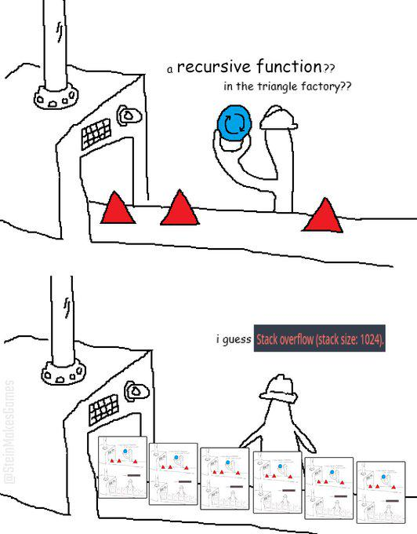
RECURSIVE ALGORITHMS
Today we’ll be looking at a handful of specific recursive algorithms
You will not need to know these specifically for the IB exam, so no need to commit them to memory!
Just try to understand the concepts!

Slide 6
GREATEST COMMON DIVISOR
Don’t ask me too much about the math behind this lol
If we continuously divide the larger number by the smaller number, we can eventually get to a state where the numbers divided have a remainder of 0
Let’s work through it step by step first
Find the GCD of 20 & 28
28 % 20 = 8
20 % 8 = 4
8 % 4 = 0
The GCD is 4

Slide 7
GREATEST COMMON DIVISOR
The Python code to accomplish this is on the right
The base case is if b = 0, meaning that we have found the gcd
Let’s work through the example of 36 and 15
def gcd(a, b): if b == 0: return a else: return gcd(b, a % b) print(gcd(36, 15))

Slide 8
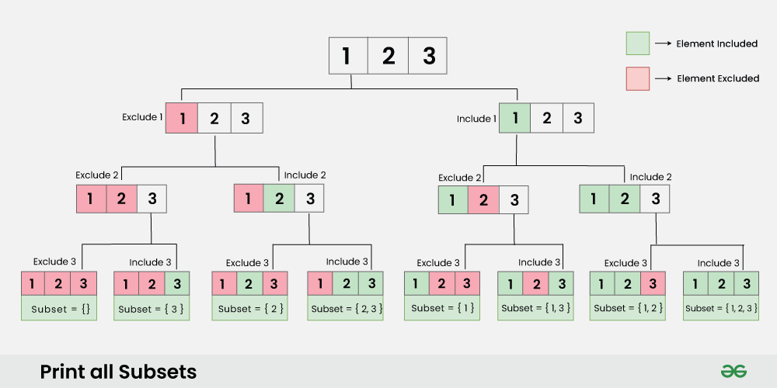
SUBSET GENERATION
If you aren’t familiar with subsets, it takes a set (list) and generates a set of sets that represent every possible combination of items from the original
For a list containing [1, 2, 3] you would get subsets of:
[ [ ], [1], [2], [3], [1,2], [2,3], [1,3], [1,2,3]]

Slide 9
SUBSET GENERATION
To generate these subsets, we’ll work in a similar fashion to the diagram on the right
We’ll have left and right recursive calls to generate the lists that represent the subsets

Slide 10
SUBSET GENERATION
Let’s break this code down
First, we call subsets(arr)
This initializes the current subset as subset
It also creates the output list that will contain all current subsets, called res
#recursive function that does all the work def subsetRecur(i, arr, res, subset): # add subset at end of array if i == len(arr): res.append(list(subset)) return # left subtree subset.append(arr[i]) subsetRecur(i + 1, arr, res, subset) # right subtree subset.pop() subsetRecur(i + 1, arr, res, subset) #function to initialize the result list def subsets(arr): subset = [] res = [] subsetRecur(0, arr, res, subset) return res arr = [1, 2, 3] res = subsets(arr) print(res)

Slide 11
SUBSET GENERATION
The subsetRecur function is the real recursive function
i represents the current item that we are looking at
arr is the initial set
#recursive function that does all the work def subsetRecur(i, arr, res, subset): # add subset at end of array if i == len(arr): res.append(list(subset)) return # left subtree subset.append(arr[i]) subsetRecur(i + 1, arr, res, subset) # right subtree subset.pop() subsetRecur(i + 1, arr, res, subset) #function to initialize the result list def subsets(arr): subset = [] res = [] subsetRecur(0, arr, res, subset) return res arr = [1, 2, 3] res = subsets(arr) print(res)

Slide 12
SUBSET GENERATION
Our base case occurs when i = len(arr)
This means we’ve looked at every item
When we’ve looked at every item, we know that our subset is complete, so we add it to res as it is complete
#recursive function that does all the work def subsetRecur(i, arr, res, subset): # add subset at end of array if i == len(arr): res.append(list(subset)) return # left subtree subset.append(arr[i]) subsetRecur(i + 1, arr, res, subset) # right subtree subset.pop() subsetRecur(i + 1, arr, res, subset) #function to initialize the result list def subsets(arr): subset = [] res = [] subsetRecur(0, arr, res, subset) return res arr = [1, 2, 3] res = subsets(arr) print(res)

Slide 13
SUBSET GENERATION
Then, we evaluate the right subtree version of this where we add the current item to the subset
The left subtree is evaluated afterwards, where the current item is not included in the subset
#recursive function that does all the work def subsetRecur(i, arr, res, subset): # add subset at end of array if i == len(arr): res.append(list(subset)) return # right subtree subset.append(arr[i]) subsetRecur(i + 1, arr, res, subset) # left subtree subset.pop() subsetRecur(i + 1, arr, res, subset) #function to initialize the result list def subsets(arr): subset = [] res = [] subsetRecur(0, arr, res, subset) return res arr = [1, 2, 3] res = subsets(arr) print(res)

Slide 14
SUBSET GENERATION
What’s the time efficiency of this algorithm?
#recursive function that does all the work def subsetRecur(i, arr, res, subset): # add subset at end of array if i == len(arr): res.append(list(subset)) return # right subtree subset.append(arr[i]) subsetRecur(i + 1, arr, res, subset) # left subtree subset.pop() subsetRecur(i + 1, arr, res, subset) #function to initialize the result list def subsets(arr): subset = [] res = [] subsetRecur(0, arr, res, subset) return res arr = [1, 2, 3] res = subsets(arr) print(res)

Slide 15
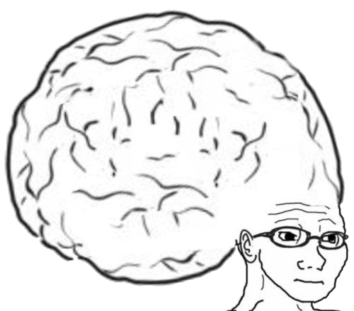
VOCAB TO REMEMBER
Recursion

Slide 16
LABBBBBB
Create a non-recursive version of the GCD program
Research how to analyze the time that a python program takes to execute
Then, using this research, time the non-recursive version you created vs the recursive version from the notes

